Slide 1
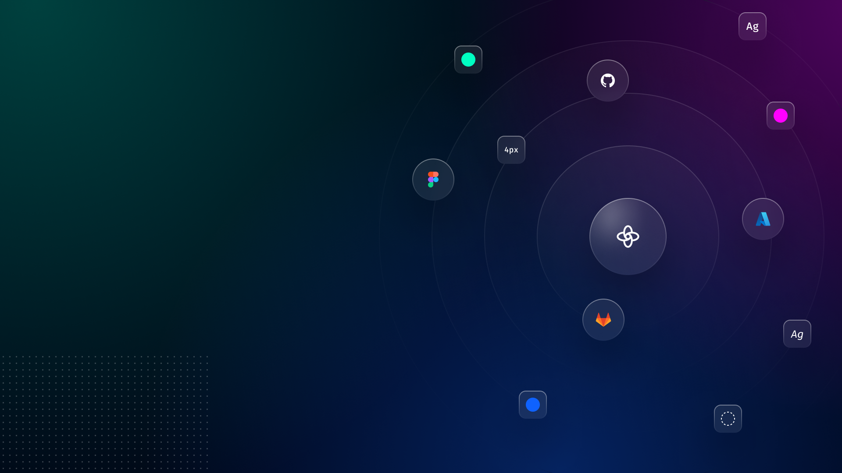
How to use this template
Brought to you by Supernova
We’ve put together a presentation deck template to help you craft the business case for your design system and get executive buy-in.
It walks through why your company should prioritize and resource a design system initiative now and how you’ll execute against the initiative.
Many of the slides have suggested content that you should update to reflect your current situation. Refer to the speaker notes for further guidance on each slide.

Slide 2
Design Systems
Business Case
Template

Slide 3
Agenda
Current challenges
Why act now?
Design system initiative
Recommendation & action plan

Slide 4
Increase revenue by releasing XYZ products in Q4 2024
Company priority
Notes:
Instructions:
Identify the top company priority that your business unit is working towards. For example, increasing revenue by releasing a new product in Q3.

Slide 5


Current challenges
Shipping too slowly
Designers & developers are wasting time re-building components (eg. designing and coding new buttons for each feature)
Key result: % products shipped on time
Poor user experience
UI/UX is inconsistent & unpredictable across the product (eg. text input varies between features) which is frustrating for users
Key result: Customer retention, Product adoption
Notes:
Instructions:
Identify the top 2-3 challenges that your business unit is facing that may hinder the company’s ability to execute and accomplish the top company priority.
Include what the key results are to measure these challenges.
Make sure these are challenges that you & your team can solve for with design systems.

Slide 6
Why do we need to act now?
Complete cross-company initiatives & opportunistic
Engineering-led initiative to migrate codebase from XYZ to ABC. Opportunity to create a design system that centralizes components and tokens.
Marketing-led initiative to re-brand product. Opportunity to create design system with the new brand and implement changes across product lines.
Strategic investment in foundations to accelerate future product development
Company-wide initiative to focus on digital transformation to keep up with or beat competitors
Major new product launch, create a design system for the new product and demonstrate how design systems accelerate development
Notes:
Instructions:
Explain why it’s important to start the design system initiative now based on what you know about your company’s current initiatives. We shared some options in the slide.
Pick a reason that’s time bound and has repercussions, such as a codebase migration, product acquisition, or rebrand.

Slide 7


Design systems enable us to do more with less.
Accelerate product development
Design & build components once and implement everywhere so we ship new products faster.
Key result: Ship new products 2x faster (avg 2 months, instead of 4 months)
Intuitive customer experience
Products have consistent UI/UX, branding, etc. which makes it easier for customers to adopt new features.
Key result: 30% more customers adopt new features
Notes:
Instructions:
Explain how design systems will solve the 2-3 challenges you posed in the prior slide. Ideally, this exactly matches with the challenges so stakeholders see the clear value.
Update the subtext to indicate how much the metric of choice would increase for each focus (eg. ship products 2x faster)

Slide 8

“Using a design system made a simple form page 47% faster to develop versus coding it from scratch.”
Learn more
Notes:
Instructions:
Include relevant quotes & stats about the benefits of design systems. We included 2 but you can find ones that are most relevant to your industry and situation.

Slide 9

Clancy Slack
“When [product designers] had access to a design system they completed their objective 34% faster than without a design system”
Learn more
Notes:
Instructions:
Include relevant quotes & stats about the benefits of design systems. We included 2 but you can find ones that are most relevant to your industry and situation.

Slide 10
Potential risks
Time
It takes time to build and implement a design system, but doing it now will make it easier to launch new products and make system-wide changes quicker.
Adoption
Using a design system requires changing how teams fundamentally work, and some people may be resistant to this.
We’ll minimize these risks by starting with a time bound MVP to showcase the practical value of design systems.
Notes:
Instructions:
Identify potential risks for rolling out a design systems initiative. This shows executives that you’ve thought this through.
Make it clear why you think it’s still worthwhile and valuable to implement design systems anyway.
Pick a reason that’s time bound and has repercussions, such as a codebase migration, product acquisition, or rebrand.

Slide 11
Design system initiative
Phase 1
Now
Get executive buy-in and select an implementation model.
Phase 2
3 months
Create MVP design system for XYZ product.
Phase 3
Next year
Expand design system to support additional products.
Notes:
Instructions:
Explain the initiative and include a realistic timeline.
Make it clear what you need stakeholders to decide on by the end of this conversation.
We suggest starting with supporting 1 key product or feature with bought in stakeholders to prove the value of design systems, and then expanding to the rest of the organization. This is the “champagne project” that Josh Clark talks about in the Business Case & ROI panel.

Slide 12

Implementation options
Hack it with
existing tools
$
Quick to start
Doesn’t scale
Limited integrations with tech stack
Missing key functionalities
3rd-party provider (Supernova)
$$
Easy to set up and implement (2-3 months)
Little to no maintenance required
Can be tailored & branded
Dedicated support team
Custom in-house solution
$$$
Resource intensive for ongoing maintenance
Takes 6+ months to develop and set up
Customizable
Notes:
Instructions:
This slide showcases the 3 main options for how to best implement a design system.
It assumes that you’ve already done the work to figure out how to best roll out a design system.

Slide 13

Implementation options
Hack it with
existing tools
$
Quick to start
Doesn’t scale
Limited integrations with tech stack
Missing key functionalities
3rd-party provider (Supernova)
$$
Easy to set up and implement (2-3 months)
Little to no maintenance required
Can be tailored & branded
Dedicated support team
Custom in-house solution
$$$
Resource intensive for ongoing maintenance
Takes 6+ months to develop and set up
Customizable
Notes:
Instructions:
This slide showcases the 3 main options for how to best implement a design system.
It assumes that you’ve already done the work to figure out how to best roll out a design system and have decided that leveraging Supernova as your 3rd-party provider is the best option.

Slide 14

Why design system with Supernova?
Save 1 day/week on product development
for teams using the design system
Increase design system team efficiency by 30% with Supernova
Implementing Supernova saves $100-500k in setup and maintenance costs in the first year, compared to a custom built solution
(Source)
Notes:
Instructions:
Identify the top 2-3 challenges that your business unit is facing that may hinder the company’s ability to execute and accomplish the top company priority.
Include what the key results are to measure these challenges.
Make sure these are challenges that you & your team can solve for with design systems.

Slide 15
Build a design system with Supernova
Recommendation

Slide 16
Action plan
Goal: Launch a design system for XYZ product using Supernova by XX/XX
Next steps:
Get budget approval for $$ to purchase Supernova plan
Finalize MVP scope and key results
How you can help:
Allocate # engineers to work on MVP for 3 months
Coordinate with teams who will be end consumers of MVP
Notes:
Instructions:
Take the broad timeline you shared in Slide 11 and identify next steps, with deadlines, and key results to quantify success.
Include budget & resourcing asks. This can include borrowed headcount from cross-functional partners (eg. 3 engineers for 6 months)
Update the “How you can help” section based on who you’re presenting to.

